Slide 1
IMPROVING THE QUALITY OF LIFE AND DEVELOPMENT IN A LARGE CITY

Slide 2
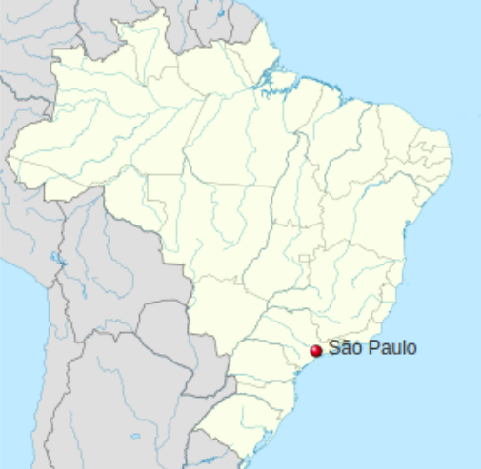
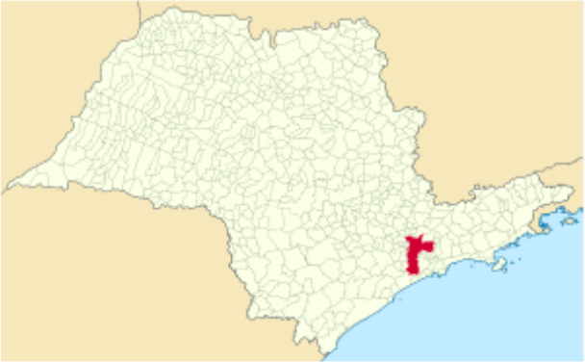
São Paulo:the most populous city in the american continent and the richest city in Brazil
São Paulo is a city in the state of São Paulo
São Paulo is a state in Brazil

Slide 3
Quality of life
São Paulo suffers from the inequality of development between the central region and the periphery;
The economic and social development of the peripheries can improve the lives of all, including
the inhabitants of the central region;
In the next slides, we will compare the quality of life in the regions of the city of São Paulo.

Slide 4
audience
This presentation is intended for those responsible for urban development in the city of São Paulo;
And for everyone else interested in better quality of life in this city.

Slide 5
Data collect - references
Wikipedia ­- São Paulo ­
Wikipedia ­- List of São Paulo's districts by population ­
Wikipedia -­ List of São Paulo’s districts by human development index ­
Human Development Index (HDI) ­
Google Maps
Foursquare
Average salary in SP goes from R$ 1.2 thousand in Marsilac to R$ 10 thousand in Campo Belo ­

Slide 6
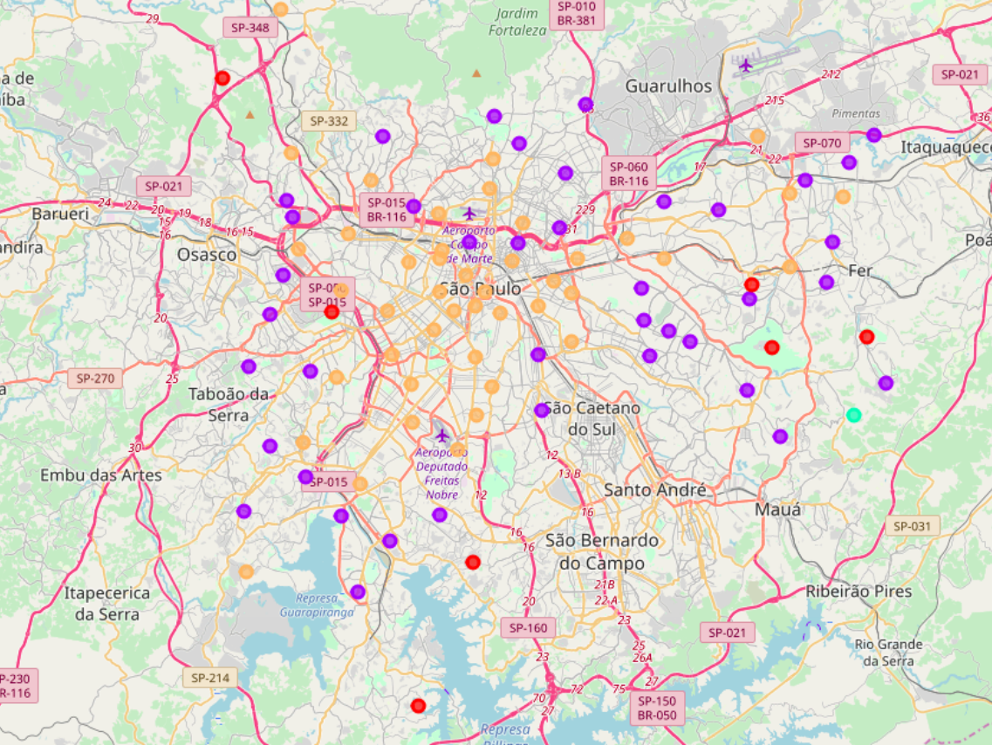
Clustering with K-means: Foursquare venues
Central cluster (yellow)
Peripheral clusters (purple, red, green)

Slide 7
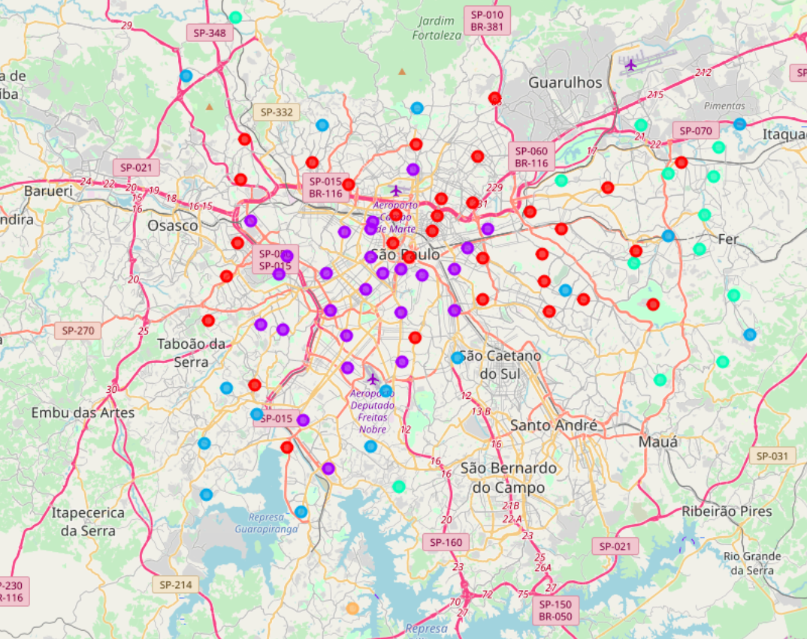
Clustering with k-means: population, HDI, Average Monthly Wage
Red cluster in north
Purple cluster in center and south
Blue, yellow and green peripherals clusters

Slide 8
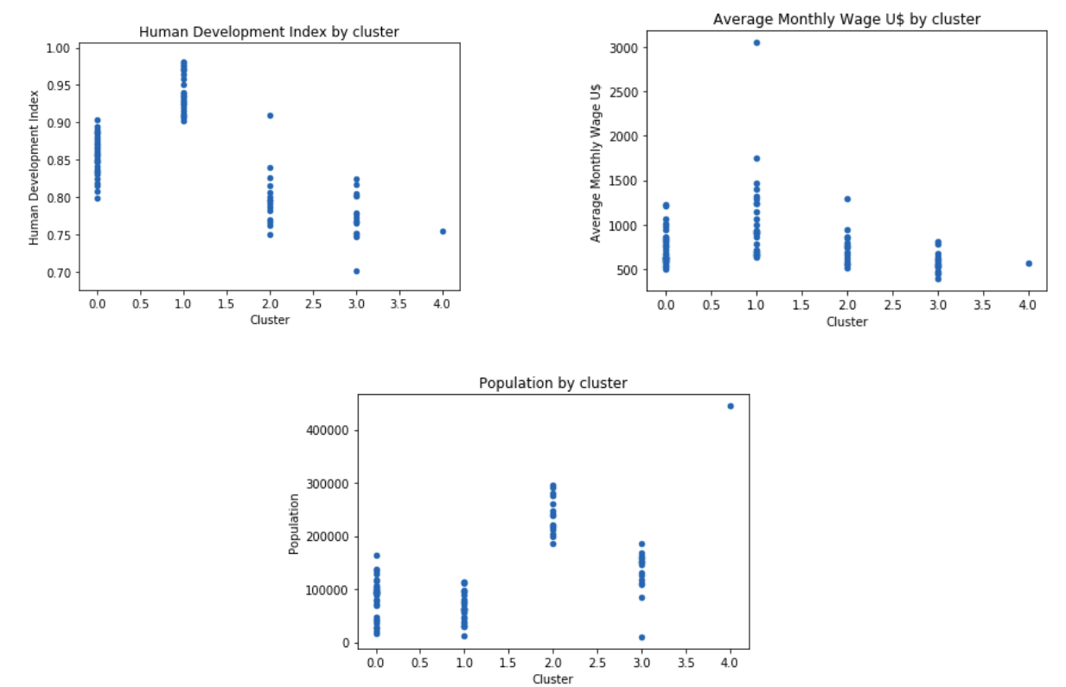
Comparing clusters

Slide 9
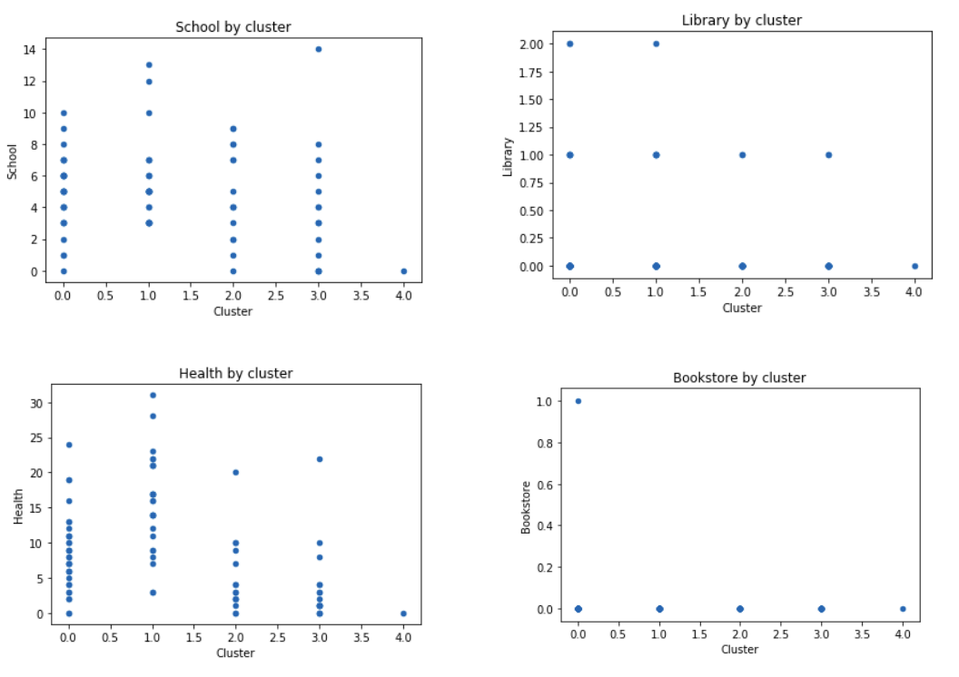
Comparing clusters

Slide 10
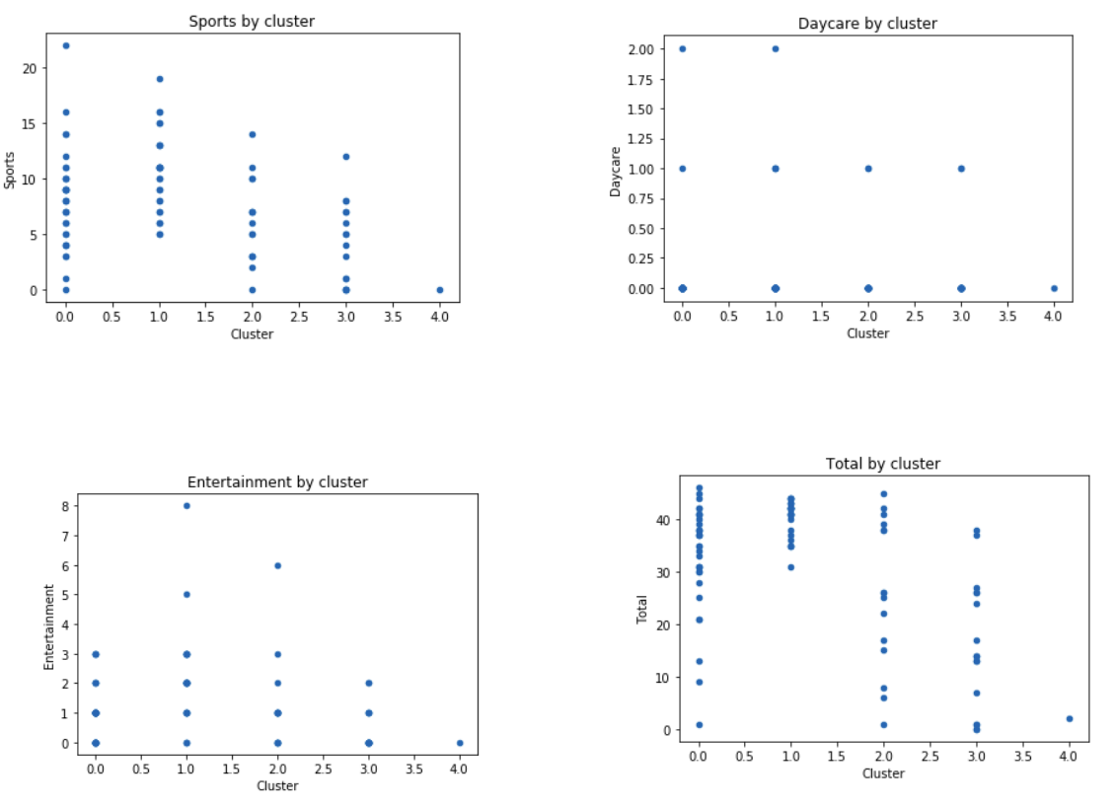
Comparing clusters

Slide 11
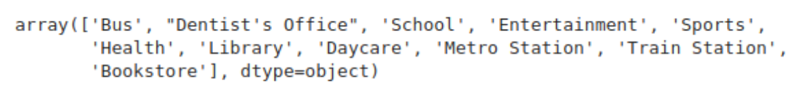
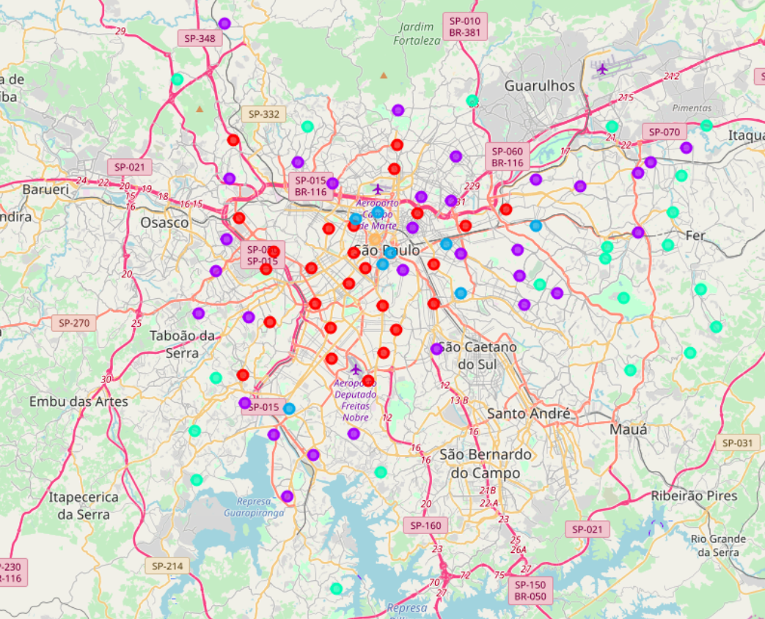
Clustering with k-means: k­means again considering HDI, wages, population and venues

Slide 12
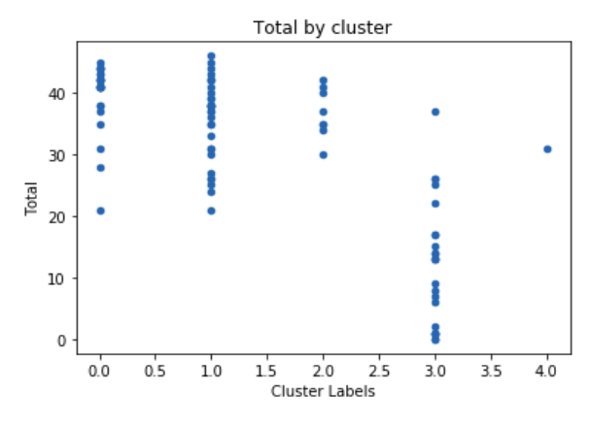
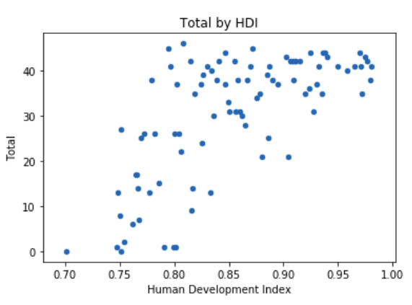
Clustering with k-means: k­means again considering HDI, wages, population and venues
Total venues x Cluster
Total venues x Human development index

Slide 13
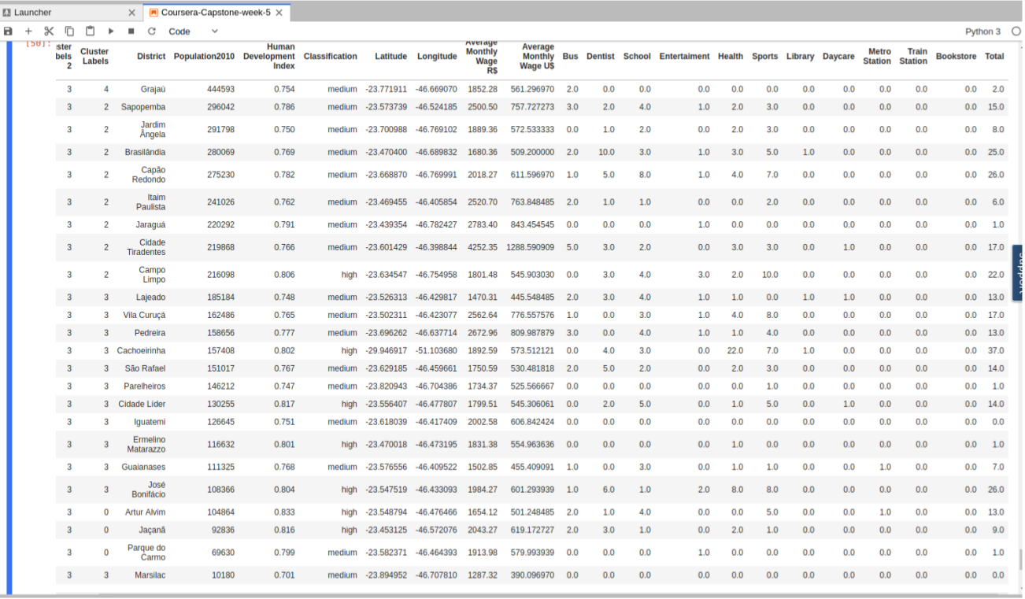
Cluster 3

Slide 14
Discussion and Conclusion
cluster 3 covers districts with a low number of selected venues (related to transport, health, education);
human development index accompanies the total of the selected venues;
To improve human development index, people needs nice health, transport, education, entertainment;
Some districts of São Paulo need improvement in these areas, mainly some districts in the extreme South and many districts of East;
The whole city needs more libraries, bookstores and daycares.

